Slide 1
COLON AND APPENDIX
BY
Dr F.O OPOOLA

Slide 2
LEARNING OBJECTIVES
What is colon
Anatomical structure of the colon
Anatomical Relations

Slide 3
INTRODUCTION
The colon (large intestine) is the distal part of the gastrointestinal tract, extending from the cecum to the anal canal.
It receives digested food from the small intestine, from which it absorbs water and electrolytes to form faeces.
Anatomically, the colon can be divided into four parts – ascending, transverse, descending and sigmoid.
These sections form an arch, which encircles the small intestine.

Slide 4
Anatomical Position
The colon averages 150cm in length, and can be divided into four parts (proximal to distal): ascending, transverse, descending and sigmoid.
Ascending Colon
The colon begins as the ascending colon, a retroperitoneal structure which ascends superiorly from the cecum.
When it meets the right lobe of the liver, it turns 90 degrees to move horizontally. This turn is known as the right colic flexure (or hepatic flexure), and marks the start of the transverse colon.
Transverse Colon
The transverse colon extends from the right colic flexure to the spleen, where it turns another 90 degrees to point inferiorly. This turn is known as the left colic flexure (or splenic flexure). Here, the colon is attached to the diaphragm by the phrenicocolic ligament.
The transverse colon is the least fixed part of the colon, and is variable in position (it can dip into the pelvis in tall, thin individuals). Unlike the ascending and descending colon, the transverse colon is intraperitoneal and is enclosed by the transverse mesocolon.

Slide 5
Descending Colon
After the left colic flexure, the colon moves inferiorly towards the pelvis – and is called the descending colon. It is retroperitoneal in the majority of individuals, but is located anteriorly to the left kidney, passing over its lateral border.
When the colon begins to turn medially, it becomes the sigmoid colon.
Sigmoid Colon
The 40cm long sigmoid colon is located in the left lower quadrant of the abdomen, extending from the left iliac fossa to the level of the S3 vertebra.
This journey gives the sigmoid colon its characteristic “S” shape.
The sigmoid colon is attached to the posterior pelvic wall by a mesentery – the sigmoid mesocolon.
The long length of the mesentery permits this part of the colon to be particularly mobile.

Slide 6
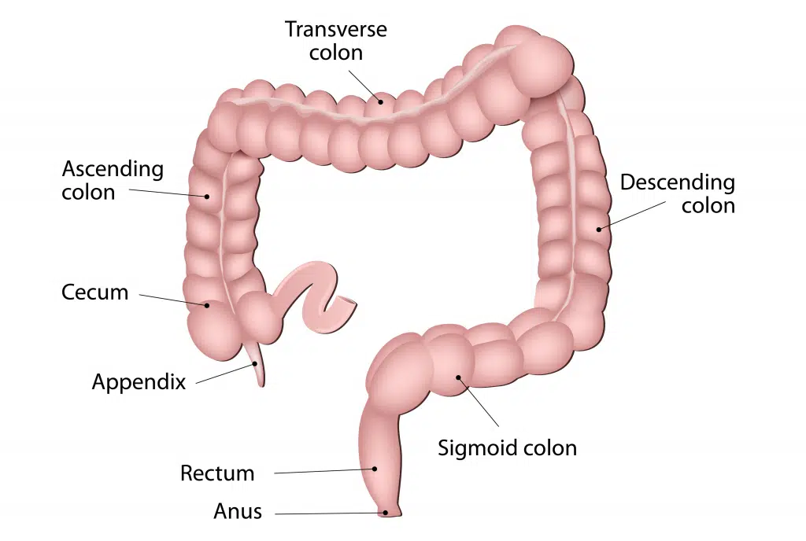
Fig 1 – The large intestine extends from the cecum to the rectum. It is comprised of the ascending, transverse, descending and sigmoid colon.

Slide 7
Paracolic Gutters
The paracolic gutters are two spaces between the ascending/descending colon and the posterolateral abdominal wall.
These structures are clinically important, as they allow material that has been released from inflamed or infected abdominal organs to accumulate elsewhere in the abdomen.

Slide 8
Anatomical Structure
The large intestine has a number of characteristic features, which allows it to be distinguished from the small intestine:
Attached to the surface of the large intestine are omental appendices – small pouches of peritoneum, filled with fat.
Running longitudinally along the surface of the large bowel are three strips of muscle, known as the teniae coli. They are called the mesocolic, free and omental coli.
The teniae coli contract to shorten the wall of the bowel, producing sacculations known as haustra.
The large intestine has a much wider diameter compared to the small intestine.
These features cease at the rectosigmoid junction, where the smooth muscle of the teniae coli broaden to form a complete layer within the rectum

Slide 9
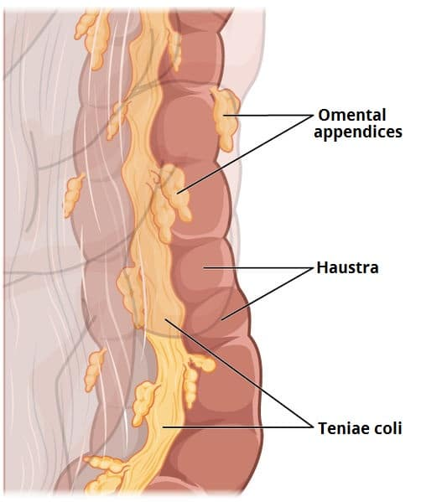
Fig 2 – The macroscopic features of the large intestine.

Slide 10
Anatomical Relations
The colon has numerous important anatomical relations in the abdomen
 | Anterior | Posterior
Ascending colon | Small intestine Greater omentum Anterior abdominal wall | Iliacus and quadratus lumborum Right kidney Iliohypogastric and ilioinguinal nerves
Transverse colon | Greater omentum Anterior abdominal wall | Duodenum Head of the pancreas Jejunum and ileum
Descending colon Sigmoid colon | Small intestine Greater omentum Anterior abdominal wall Urinary bladder Uterus and upper vagina (females only) | Iliacus and quadratus lumborum Left kidney Sacrum Ileum

Slide 11
Neurovascular Supply
The neurovascular supply to the colon is closely linked to its embryological origin:
Ascending colon and proximal 2/3 of the transverse colon – derived from the midgut.
Distal 1/3 of the transverse colon, descending colon and sigmoid colon – derived from the hindgut.
Arterial Supply
As a general rule, midgut-derived structures are supplied by the superior mesenteric artery, and hindgut-derived structures by the inferior mesenteric artery.
The ascending colon receives arterial supply from two branches of the superior mesenteric artery; the ileocolic and right colic arteries. The ileocolic artery gives rise to colic, anterior cecal and posterior cecal branches – all of which supply the ascending colon.
The transverse colon is derived from both the midgut and hindgut, and so it is supplied by branches of the superior mesenteric artery and inferior mesenteric artery:
Right colic artery (from the superior mesenteric artery) Middle colic artery (from the superior mesenteric artery)
Left colic artery (from the inferior mesenteric artery)
The descending colon is supplied by a single branch of the inferior mesenteric artery; the left colic artery. The sigmoid colon receives arterial supply via the sigmoid arteries (branches of the inferior mesenteric artery).

Slide 12
Marginal Artery of Drummond
The marginal artery (of Drummond) is a clinically important vessel that provides collateral supply to the colon – thereby maintaining arterial supply in the case of occlusion or stenosis of one of the major vessels.
As the terminal vessels of the superior mesenteric and inferior mesenteric artery approach the colon, they split into many branches, which anastomose with each other.
These anastomoses form a continuous arterial channel which extends the length of the colon – the marginal artery. Long, straight arterial branches (called vasa recta) arise from the marginal artery to supply the colon.

Slide 13
Venous Drainage
The venous drainage of the colon is similar to the arterial supply:
Ascending colon – ileocolic and right colic veins, which empty into the superior mesenteric vein.
Transverse colon – middle colic vein, which empties into the superior mesenteric vein.
Descending colon – left colic vein, which drains into the inferior mesenteric vein.
Sigmoid colon – drained by the sigmoid veins into the inferior mesenteric vein.
The superior mesenteric and inferior mesenteric veins ultimately empty into the hepatic portal vein. This allows toxins absorbed from the colon to be processed by the liver for detoxification.

Slide 14
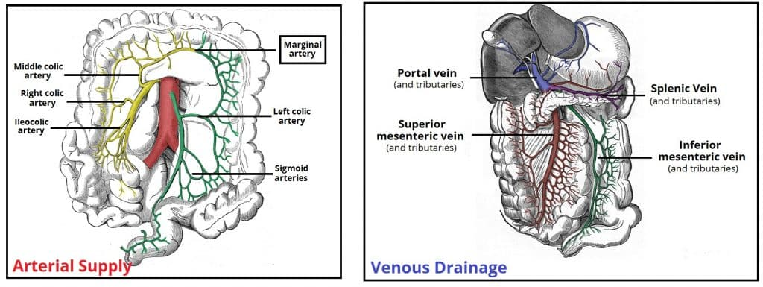

Slide 15
Innervation
The innervation to the colon is dependent on embryological origin:
Midgut-derived structures (ascending colon and proximal 2/3 of the transverse colon) receive their sympathetic, parasympathetic and sensory supply via nerves from the superior mesenteric plexus.
Hindgut-derived structures (distal 1/3 of the transverse colon, descending colon and sigmoid colon) receive their sympathetic, parasympathetic and sensory supply via nerves from the inferior mesenteric plexus:
  Parasympathetic innervation via the pelvic splanchnic nerves
  Sympathetic innervation via the lumbar splanchnic nerves.

Slide 16
Lymphatic Drainage
The lymphatic drainage of the ascending and transverse colon is into the superior mesenteric nodes. The descending colon and sigmoid drain into the inferior mesenteric nodes.
Most of the lymph from the superior mesenteric and inferior mesenteric nodes passes into the intestinal lymph trunks, and on to the cisterna chyli – where it ultimately empties into the thoracic duct.

Slide 17
APPENDIX
The appendix is a narrow blind-ended tube that is attached to the posteromedial end of the cecum (large intestine).
It contains a large amount of lymphoid tissue but is not thought to have any vital functions in the human body.

Slide 18
Anatomical Structure and Relations
The appendix originates from the posteromedial aspect of the cecum. It is supported by the mesoappendix, a fold of mesentery which suspends the appendix from the terminal ileum.
The position of the free-end of the appendix is highly variable and can be categorised into seven main locations depending on its relationship to the ileum, caecum or pelvis.
The most common position is retrocecal. They may also be remembered by their relationship to a clock face:
Pre-ileal – anterior to the terminal ileum – 1 or 2 o’clock.
Post-ileal – posterior to the terminal ileum – 1 or 2 o’clock.
Sub-ileal – parallel with the terminal ileum – 3 o’clock.
Pelvic – descending over the pelvic brim – 5 o’clock.
Subcecal – below the cecum – 6 o’clock.
Paracecal – alongside the lateral border of the cecum – 10 o’clock.
Retrocecal – behind the cecum – 11 o’clock.

Slide 19
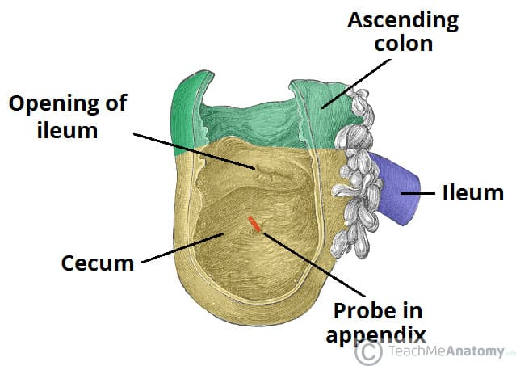
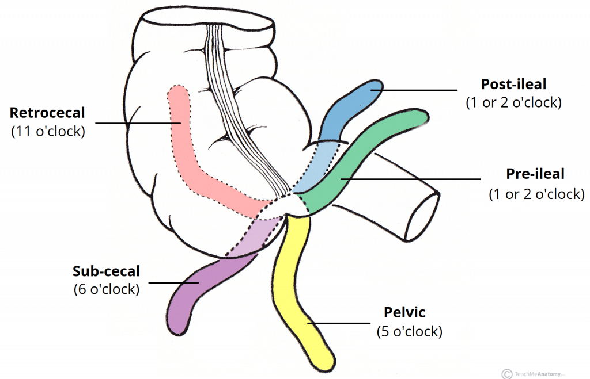
The cecum. Note the blind end inferiorly, and its continuity with the ascending colon superiorly.
The common positions of the appendix. The most common position is retrocecal.

Slide 20
Neurovascular Supply
The appendix is derived from the embryologic midgut. Therefore, the vascular supply is via branches of the superior mesenteric vessels.
Arterial supply is from the appendicular artery (derived from the ileocolic artery, a branch of the superior mesenteric artery) and venous drainage is via the corresponding appendicular vein. Both are contained within the mesoappendix.
Sympathetic and parasympathetic branches of the autonomic nervous system innervate the appendix.
This is achieved by the ileocolic branch of the superior mesenteric plexus. It accompanies the ileocolic artery to reach the appendix.
Note: Of clinical relevance, the sympathetic afferent fibres of the appendix arise from T10 of the spinal cord – thus explaining why the visceral pain of early appendicitis is felt centrally within the abdomen.

Slide 21
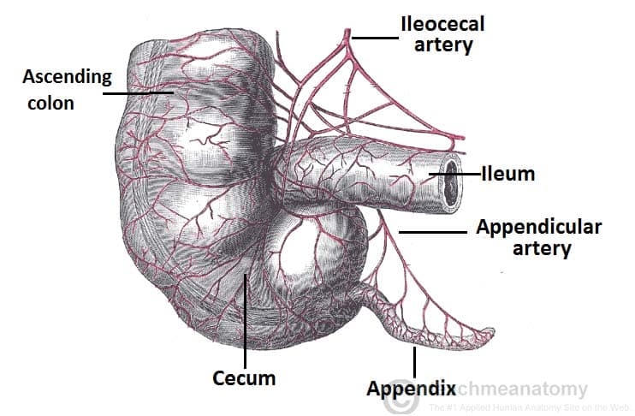
Arterial supply to the cecum and appendix via the ileocecal artery.

Slide 22
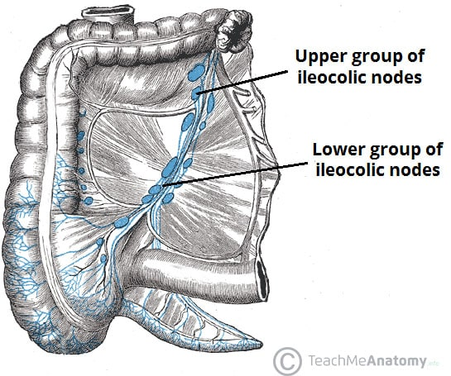
Lymphatic Drainage
Lymphatic fluid from the appendix drains into lymph nodes within the mesoappendix and into the ileocolic lymph nodes (which surround the ileocolic artery).
Lymphatic drainage of the cecum and appendix.

Slide 23
Clinical Relevance: Inflammation of the Appendix
Inflammation of the appendix is known as appendicitis, and is a common cause for acute severe abdominal pain. In established appendicitis, the abdomen is most tender at McBurney’s point – situated one third of the distance from the right anterior superior iliac spine to the umbilicus. This corresponds to the location of the base of the appendix when it lies in a retrocecal position.
The aetiology of appendicitis depends on age. In the young, it is mostly due to an increase in lymphoid tissue size, which occludes the lumen. From 30 years old onwards, it is more likely to be blocked due a faecolith.

Slide 24
Initially, pain from the appendix and its visceral peritoneum is referred to the umbilical region. As the appendix becomes increasingly inflamed, it irritates the parietal peritoneum, causing the pain to localise to the right lower quadrant.
If the appendix is not removed, it can become necrotic and rupture, resulting in peritonitis (inflammation of the peritoneum).

